Slide 1
Ablation Modelling using Ansys Fluent Version: 2024R1

Slide 2
Introduction
Ablation is an effective treatment used to protect a vehicle from the damaging effects of external high temperatures. During high-speed vehicle operations (for example, vehicle reentry), the ablative coating is chipped away to remove excessive amount of heat from the surface of the vehicle.
This tutorial demonstrates how to do the following:
Define boundary conditions for a high-speed flow.
Set up the ablation model to model effects of a moving boundary due to ablation.
Initiate and solve the transient simulation using the density-based solver
Note: This Simulation runs with cfd_hsf license increment.
“Please ensure that you have hsf library before working on this tutorial.”

Slide 3
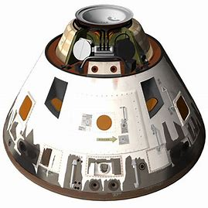
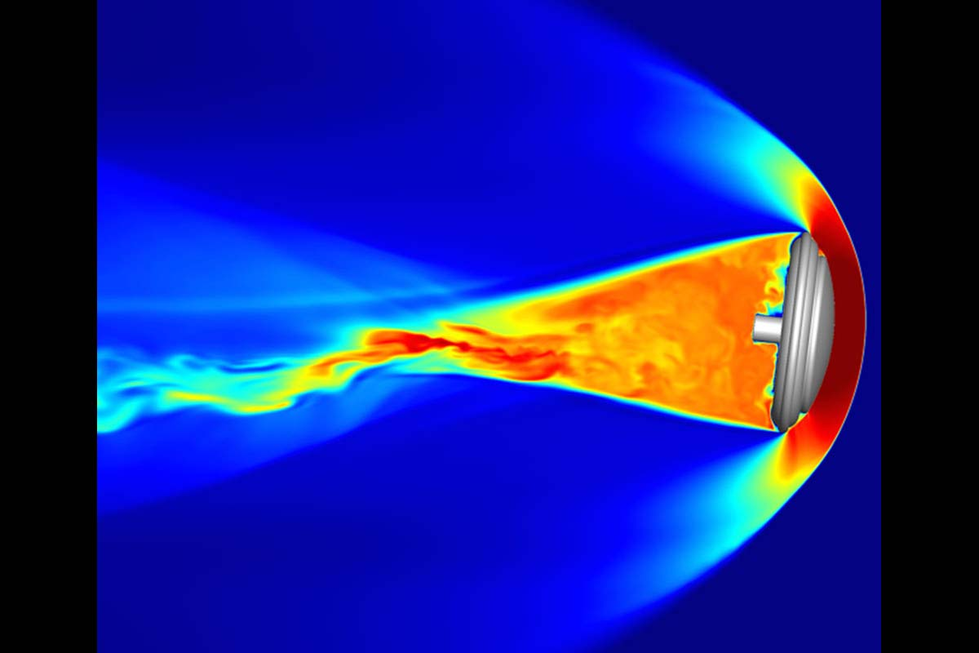
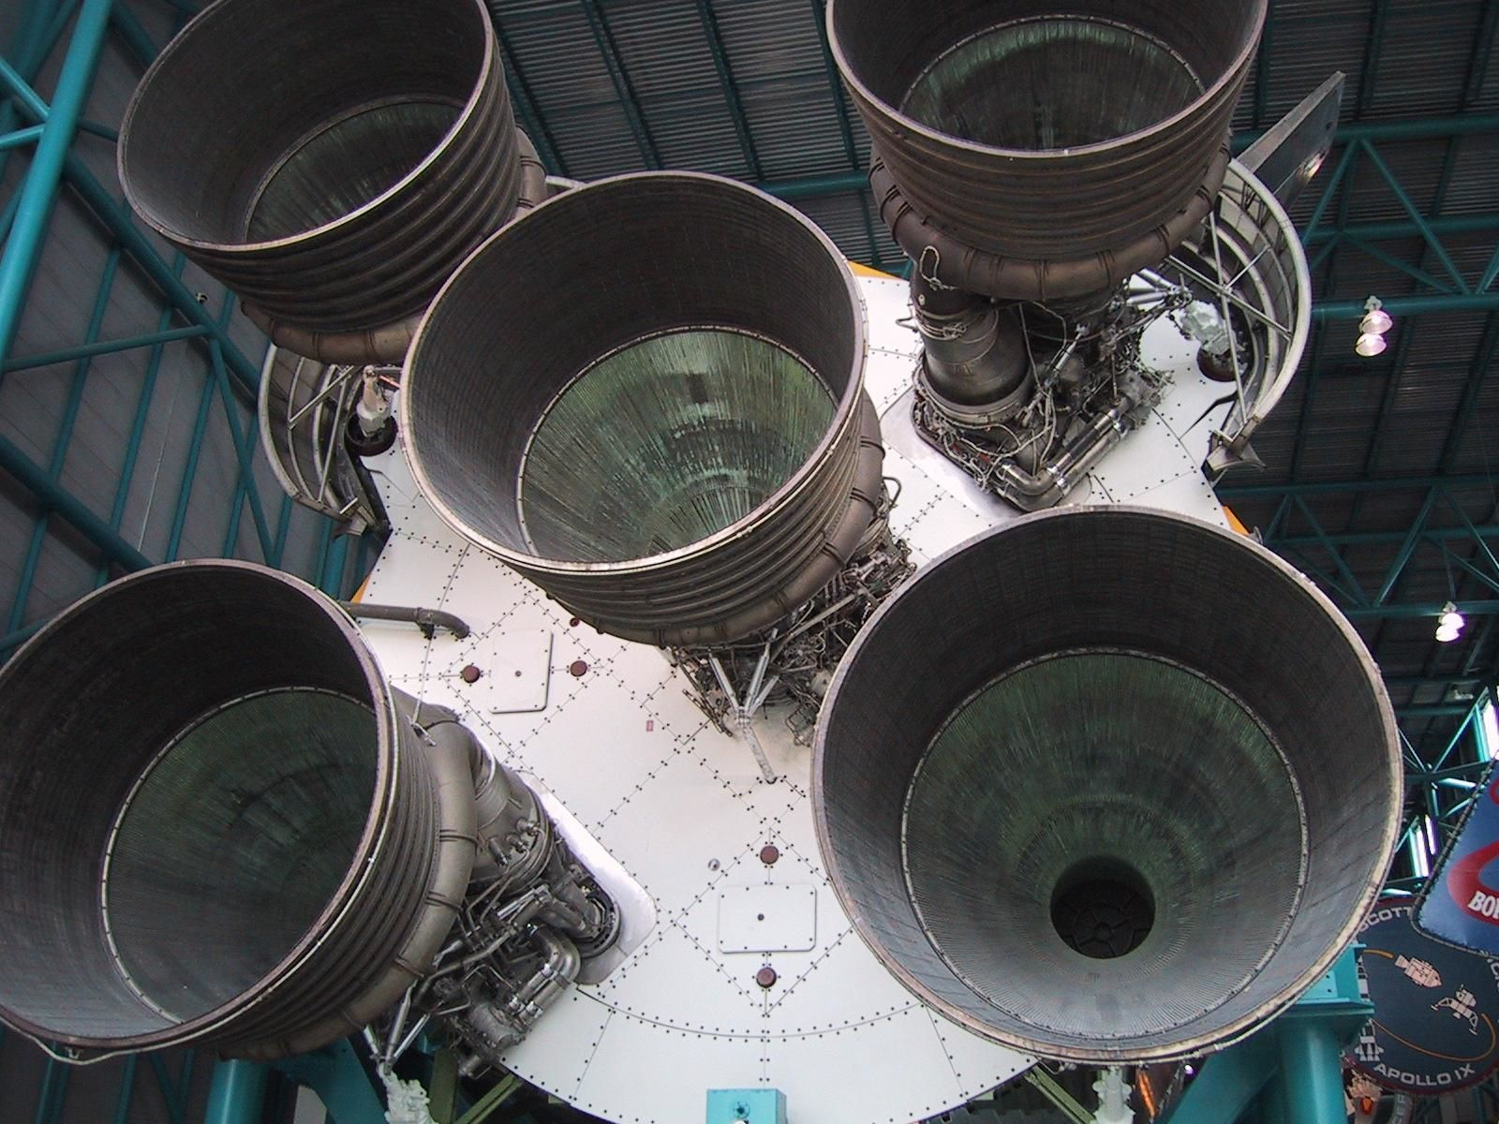
Introduction
Examples of Ablative materials:

Slide 4
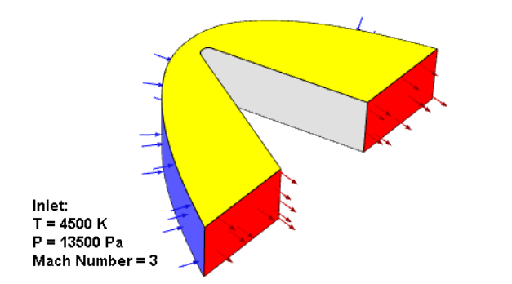
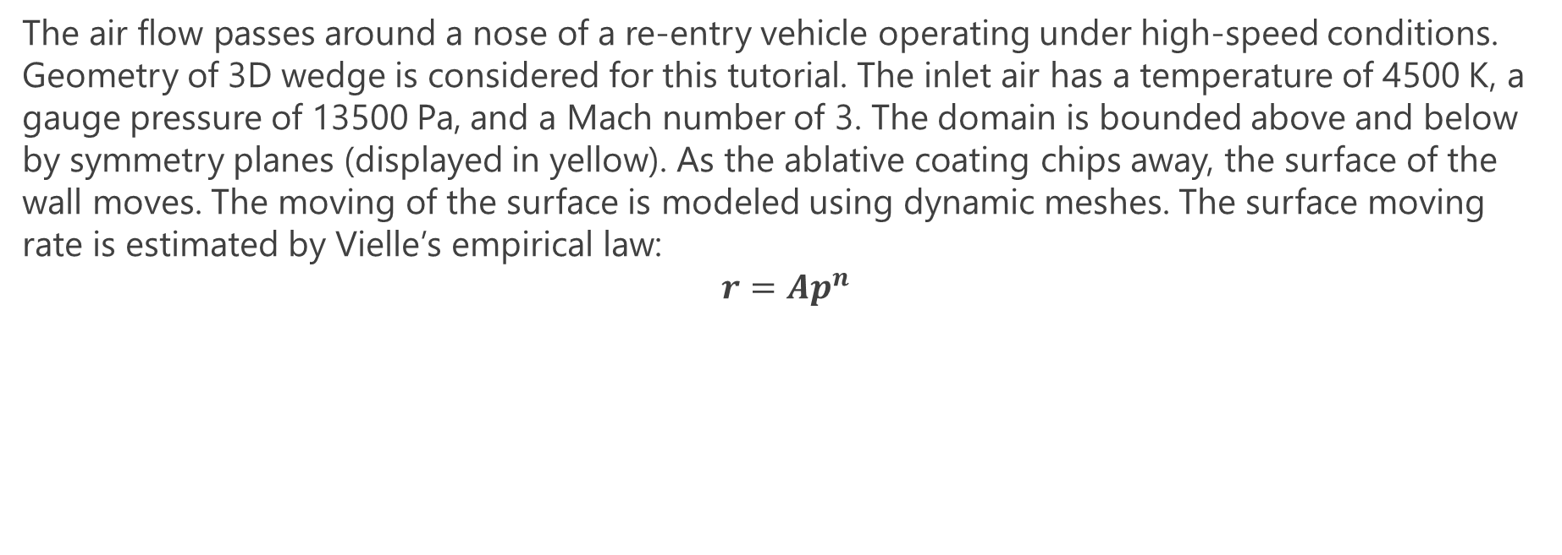
Problem Description
The air flow passes around a nose of a re-entry vehicle operating under high-speed conditions. Geometry of 3D wedge is considered for this tutorial. The inlet air has a temperature of 4500 K, a gauge pressure of 13500 Pa, and a Mach number of 3. The domain is bounded above and below by symmetry planes (displayed in yellow). As the ablative coating chips away, the surface of the wall moves. The moving of the surface is modeled using dynamic meshes. The surface moving rate is estimated by Vielle’s empirical law:
$$r=Ap^{n}$$

Slide 5
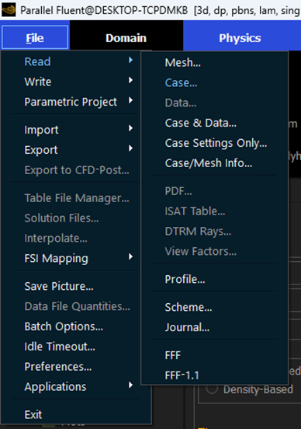
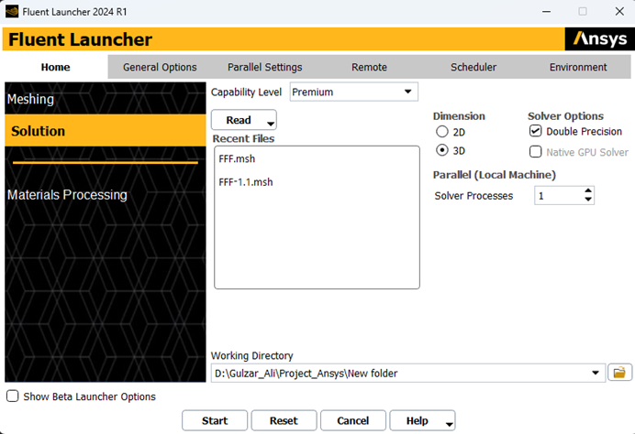
Setting up Simulation Environment
Download the case files for Ablation Modelling
Read the case files using ansys Fluent
Top left corner of fluent window. Read the case file provided with this tutorial.

Slide 6
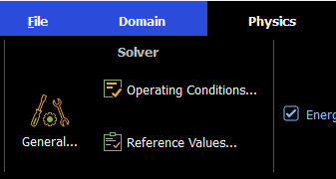
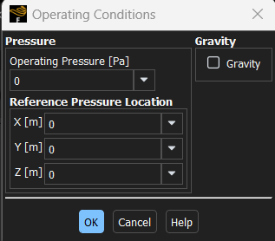

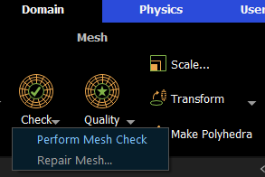
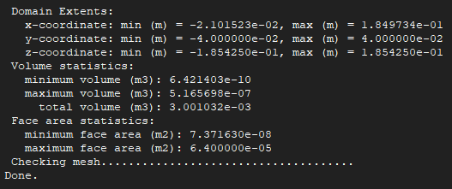
Setting up Simulation Environment
Ensure that the reported minimum volume is a positive number.
Select Physics > Solver > Operating Conditions:
Define the Operating Conditions for your Model

Slide 7
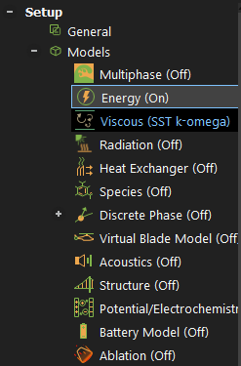

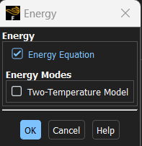
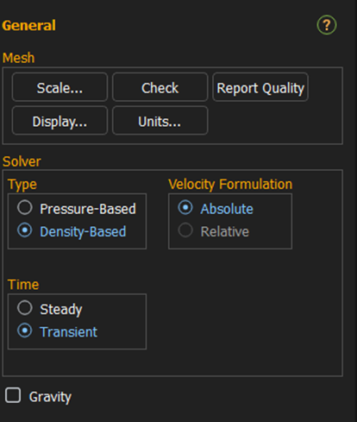
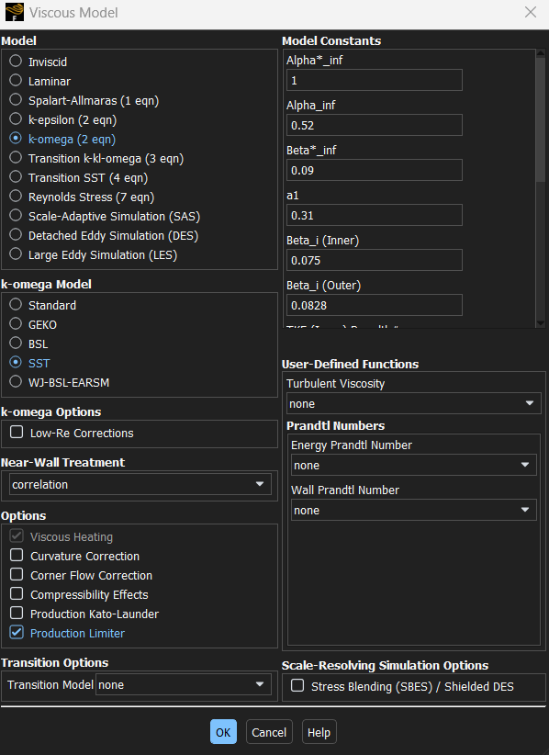

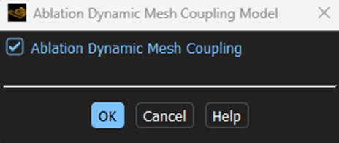
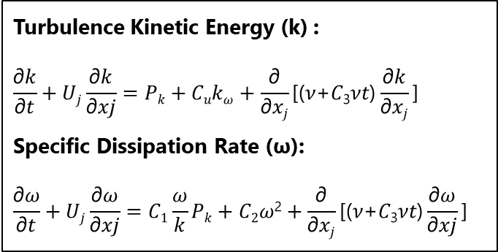
Setting up Simulation Environment
Select Steady solver with Transient Time
Turbulence Kinetic Energy (k) :
$$\frac{\text{∂}\text{k}}{\text{∂}\text{t}}+\text{U}\text{j}\frac{\text{∂}\text{k}}{\text{∂}\text{xj}}=Pk+Cuk\text{ω}+\frac{\text{∂}}{\text{∂}\text{xj}}\text{[(}\text{ν}\text{+}\text{C}\text{3}\text{ν}\text{t}\text{)}\frac{\text{∂}\text{k}}{\text{∂}\text{xj}}\text{]}$$
​Specific Dissipation Rate (ω):
$$\frac{\text{∂}\text{ω}}{\text{∂}\text{t}}+\text{U}\text{j}\frac{\text{∂}\text{ω}}{\text{∂}\text{xj}}=C1\frac{\text{ω}}{k}Pk+C2\text{ω}\text{2}+\frac{\text{∂}}{\text{∂}\text{x}j}\text{[(}\text{ν}\text{+}\text{C}\text{3}\text{ν}\text{t}\text{)}\frac{\text{∂}\text{ω}}{\text{∂}\text{xj}}\text{]}$$

Slide 8
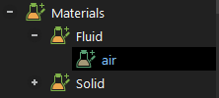
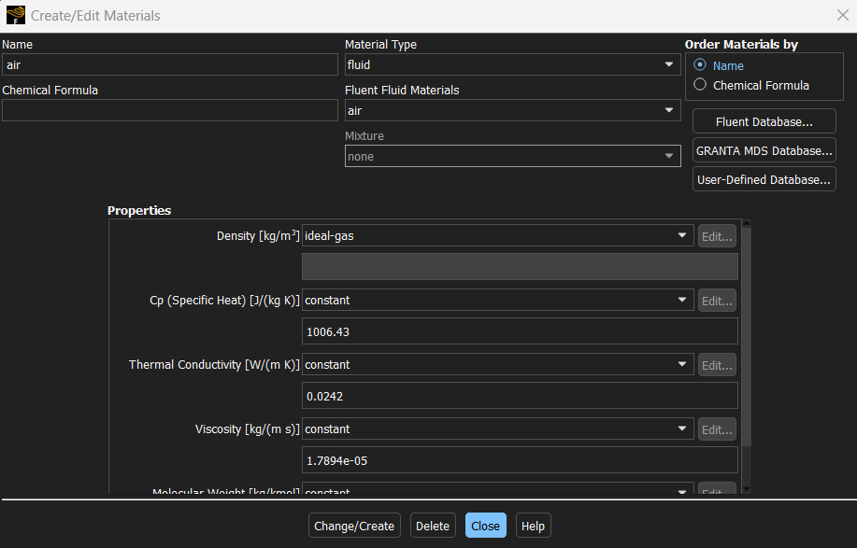

Materials

Slide 9
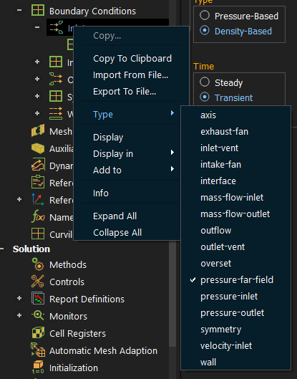
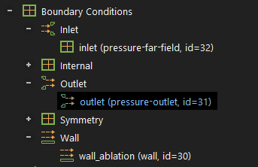
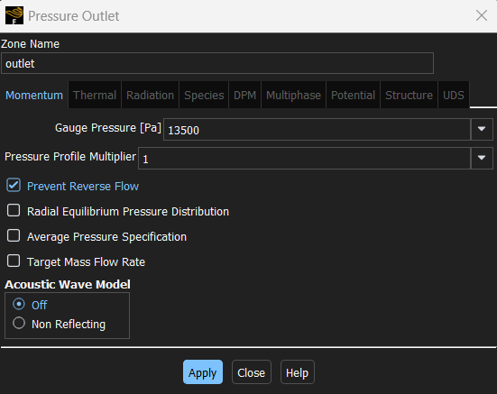
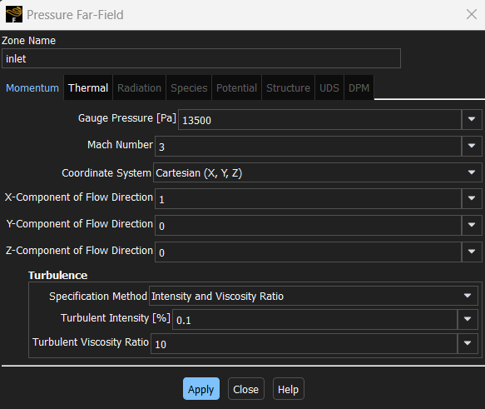
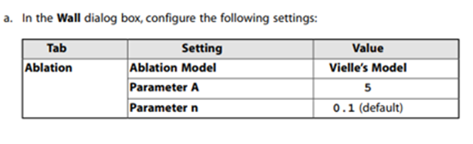

Boundary Conditions
$$r=Ap^{n}$$

Slide 10
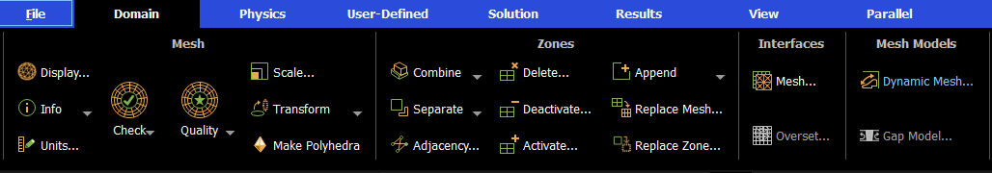
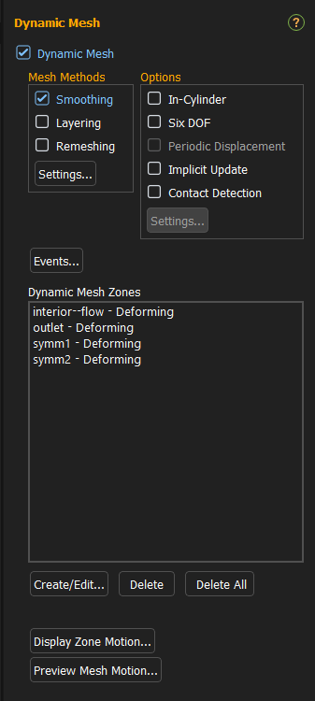
Dynamic Mesh
Moving Mesh provides capability of tackling flow simulations where the domain shape changes during the simulation.

Slide 11
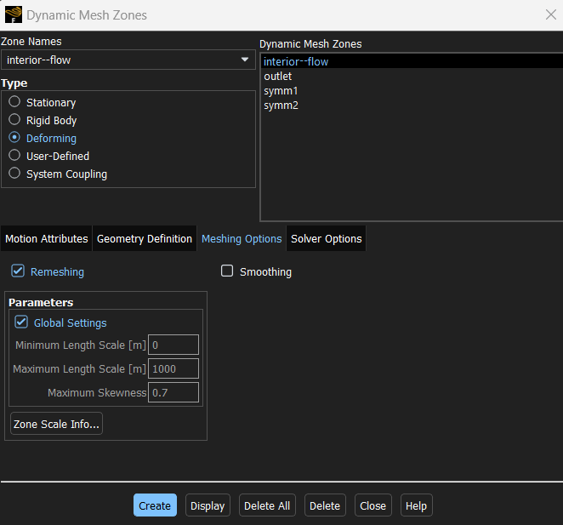
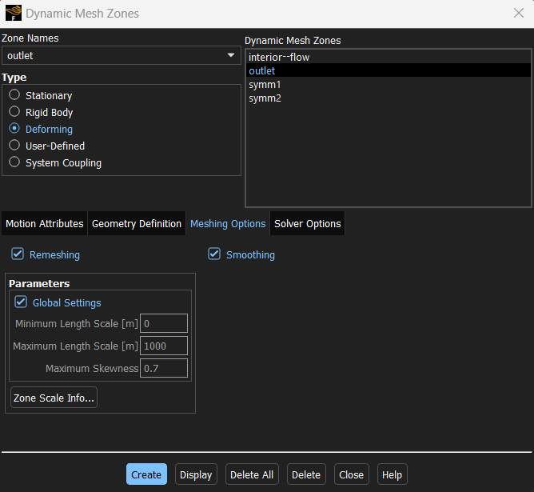
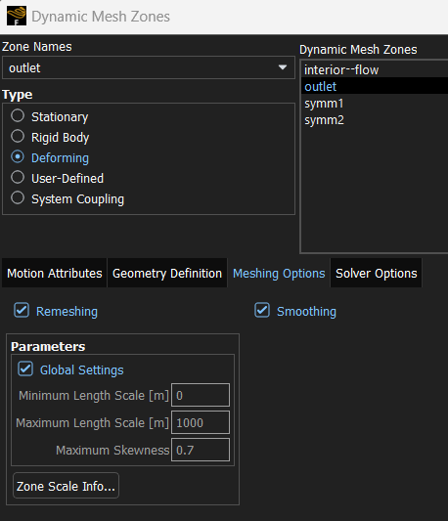
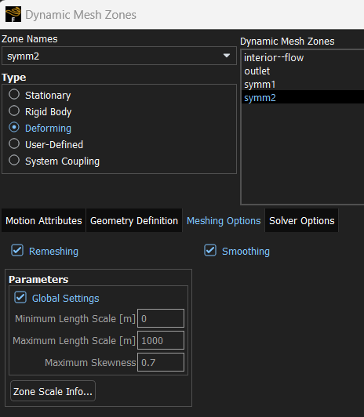
Dynamic Mesh
Similarly create dynamic zone for Ablation Wall
> select User-Defined in Type list > In meshing options, enable Deform Adjacent Boundary Layer with Zone.

Slide 12
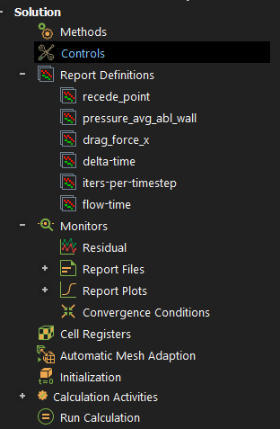
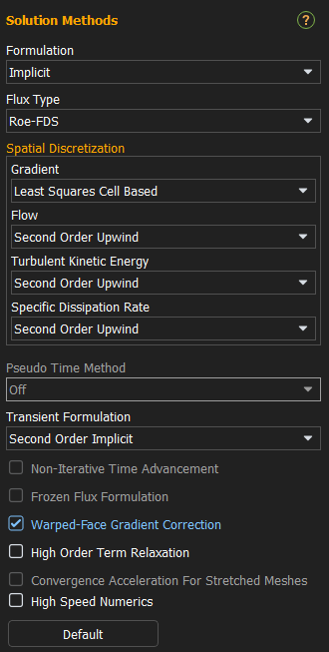
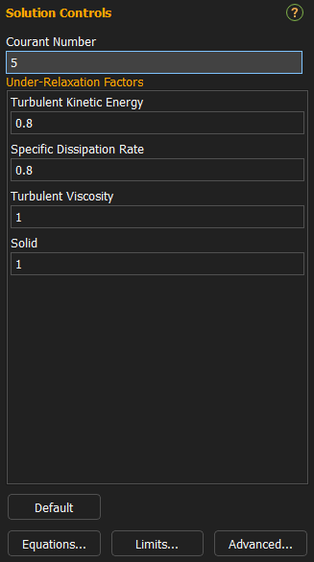
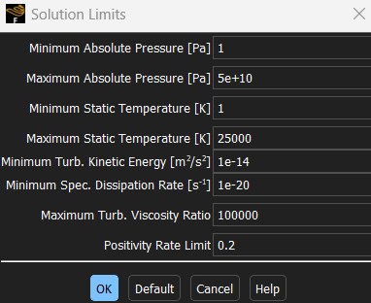
Solution Methods
Roe-FDS splits the fluxes in a manor that is consistent with their corresponding flux method eigenvalues.
Check Solution Limits >Adjust your maximum Static Temperature.
Select the Implicit and Roe-FDS in Solution Methods.
For Discretization Select Least Squares Cell Based

Slide 13
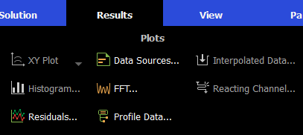
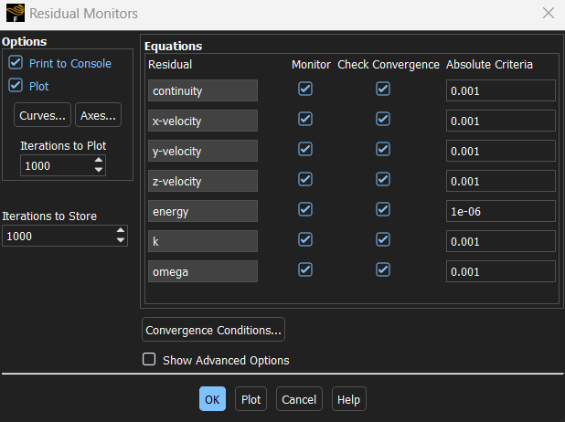
Solution Methods

Slide 14
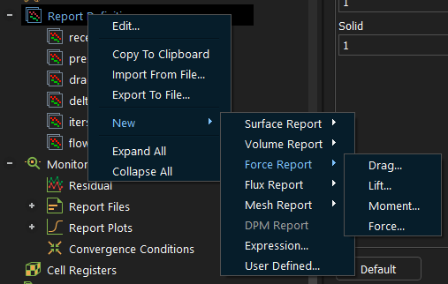
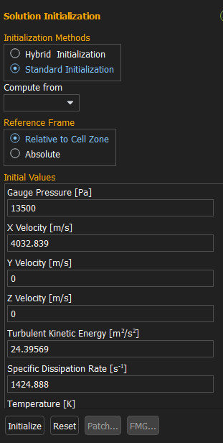
Solution Methods
Select Standard Initialization
Select Inlet
For Generating reports:
Right click Report Definition > Select New > Select relevant Report > Select your parameter.

Slide 15
Results and Calculations
Run the Simulations > Visualize the generated plots

